Slide 1


Exploratory Data Analysis facebook sample data

Slide 2
Project analysis slide 2
Approach
CONCLUSION AND
INSIGHTS
DESCRIPTION OF DATASET
PROJECT
EXPLORATORY DATA
ANALYSIS
PROFILING BEFORE PREPROCESSING
PROFILING AFTER
PROCESSING
DATA PREPROCESSING
Notes:
the approach for this presentation is as follows:
Step 1 - I will begin with a description of the dataset
Step 2 - Will be profiling of the dataset to understand the correctness and completeness of the data available
Step 3 - is preprocessing of the data to ensure that a clean and usable dataset is available for exploratory data analysis
In Step 4 i will profile the dataset again to ensure that there have been no errors in preprocessing
Step 5 is preforming exploratory data analysis on multiple variables in the dataset
The last step is a summarization of the exploratory data analysis and insights which serve as recommendations for improvement

Slide 3
Project analysis slide 2
Dataset
SOURCE : CSV file.
LOCATION : github
DATA SAMPLE:
 | userid | age | dob_day | dob_year | dob_month | gender | tenure | friend_count | friendships_initiated | likes | likes_received | mobile_likes | mobile_likes_received | www_likes | www_likes_received
0 | 2094382 | 14 | 19 | 1999 | 11 | male | 266.0 | 0 | 0 | 0 | 0 | 0 | 0 | 0 | 0
1 | 1192601 | 14 | 2 | 1999 | 11 | female | 6.0 | 0 | 0 | 0 | 0 | 0 | 0 | 0 | 0
2 | 2083884 | 14 | 16 | 1999 | 11 | male | 13.0 | 0 | 0 | 0 | 0 | 0 | 0 | 0 | 0
3 | 1203168 | 14 | 25 | 1999 | 12 | female | 93.0 | 0 | 0 | 0 | 0 | 0 | 0 | 0 | 0
4 | 1733186 | 14 | 4 | 1999 | 12 | male | 82.0 | 0 | 0 | 0 | 0 | 0 | 0 | 0 | 0

Slide 4
Project analysis slide 2
Profiling before processing
Number of variables | 15
Number of observations | 99003
Missing cells | 177
Missing cells (%) | < 0.1%
Duplicate rows | 0
Duplicate rows (%) | 0.0%
Variable types
NUM | 14
CAT | 1
Observations:
user id column has 100% unique values
age and dob_year are highly correlated
gender column has 175 (0.2%) missing values
tenure has 2 (<0.1%) missing values
dob_year has 101 distinct values
age column can be used to aggregate data present in dob_year, dob_month and dob_day columns
The columns user id, dob_day, dob_month and dob_year can be excluded from further analysis
Notes:
The following observations were made after profiling of the dataset using pandas profiling:
The dataset contains 99003 observations, i.e rows
There are 15 columns, 14 numerical and 1 categorical
177 cells have missing data, which represents less than 0.1% of the total data.
The gender column has 175 missing values and tenure column has 2 missing values
userid has 100% unique values,
and can be excluded from further analysis as it is just a unique identifier for each user and does not add value from an analysis perspective
As age column data is derived from dob_day, dob_month & dob_year columns,
the dob_day, month and year columns can be excluded from further analysis as the age column adequately summarizes the data present in these columns

Slide 5
Project analysis slide 2
Data preprocessing
The columns user id, dob_day, dob_month and dob_year have been excluded from further analysis
The 2 missing values in tenure column have been replaced by median value
Rows with 175 missing gender values have been removed
Before
After
Number of variables | 15 | 11
Number of observations | 99003 | 98828
Missing cells | 177 | 0
Missing cells (%) | < 0.1% | 0%
Duplicate rows | 0 | 0
Duplicate rows (%) | 0.0% | 0.0%
Variable types
NUM | 14 | 10
CAT | 1 | 1

Slide 6
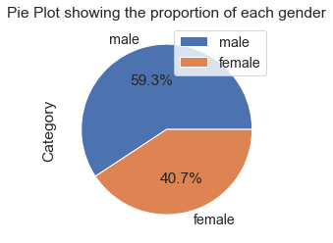
Project analysis slide 2
EDA
What % of facebook users are male and what % are female?
think of ways to be more appealing, user-friendly and convenient to the female gender
59.3% of facebook users are male and 40.7% are female
This implies that male users exceed female users by 18.6 percent

Slide 7
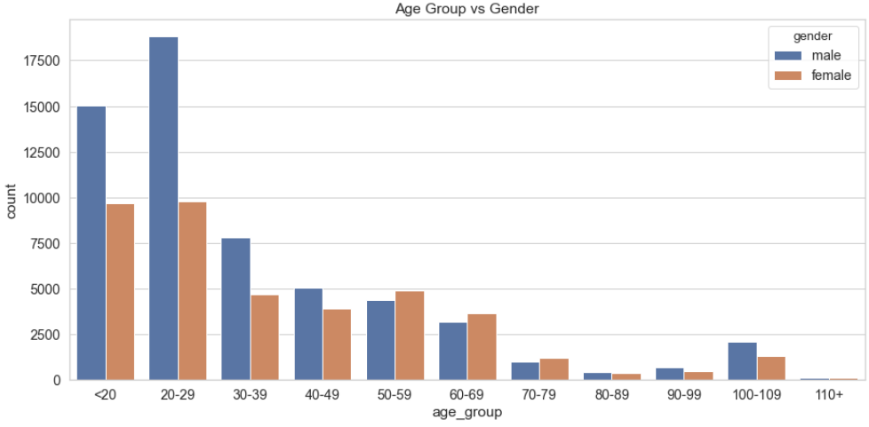
Project analysis slide 2
EDA
How is the age group distributed for male and female users?
Conduct a study of females between 20-50 years to understand why females in this age group have less facebook accounts compared to males.
Males aged 20-29 years is the highest user base. Majority of female users are aged <20 years
The number of female facebook users are less than male users for all age groups except for 50-59 yrs, 60-69 years, and 70-79 years

Slide 8
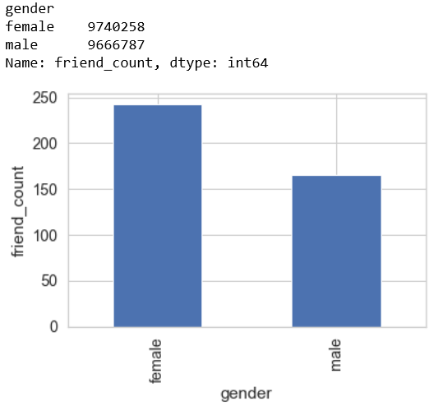
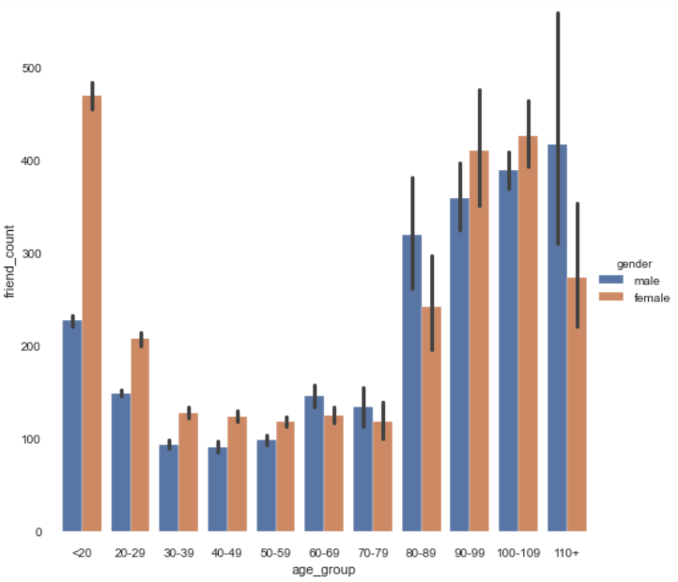
Project analysis slide 2
EDA
Is there a difference between how males and females socialize through facebook friends?
Implement initiatives to promote more facebook friends for male users, particularly males aged <50 years.
Females <20 years have the highest number of facebook friends
On an average, females have more friends compared to males.

Slide 9
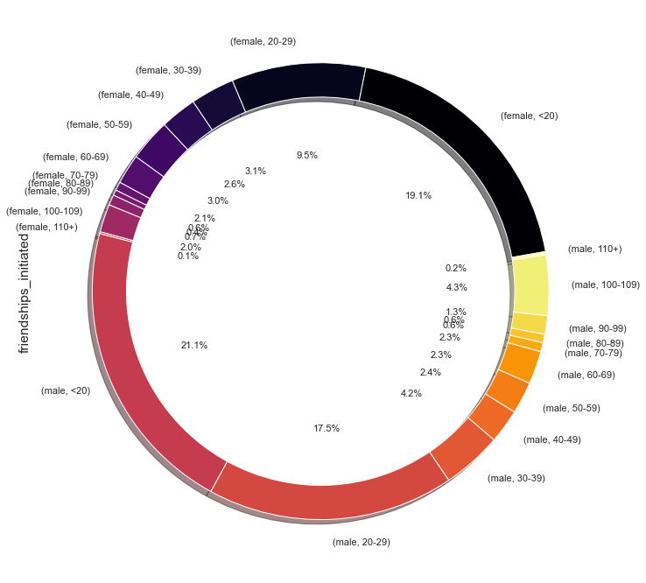
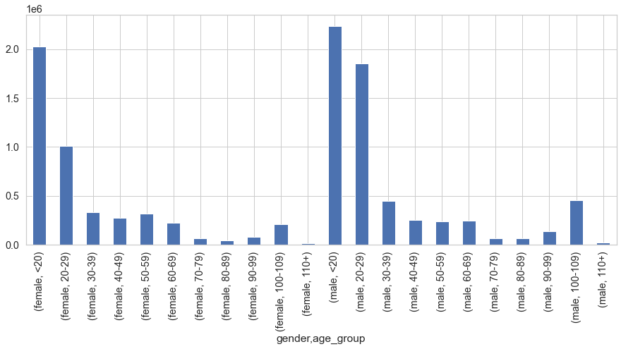
Project analysis slide 2
EDA
What is the behavior on initiating friendships across age and gender?
Friendships initiated reduces drastically beyond 30 years of age
For users above 30 years, facebook should focus on parameters apart from suggesting new friends.

Slide 10
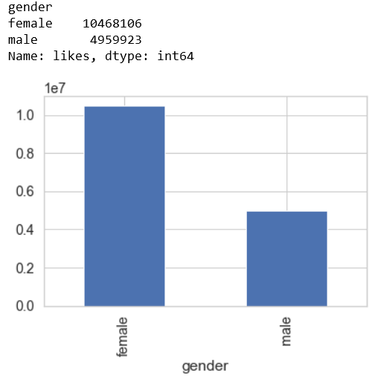
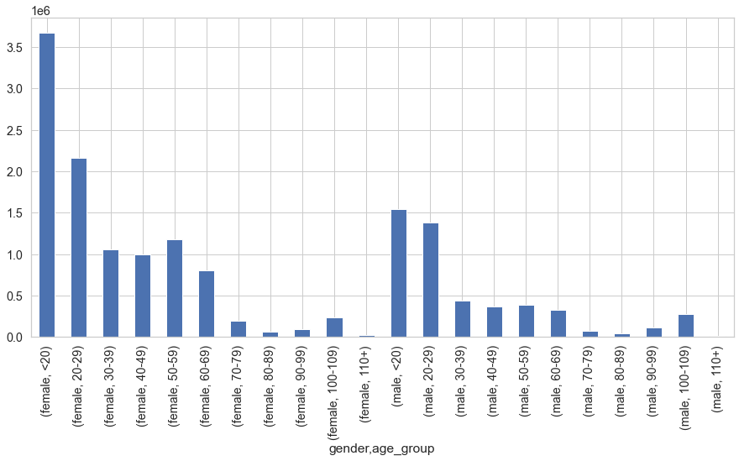
Project analysis slide 2
EDA
How do users behave in terms of posting likes?
Total Likes
Females post significantly higher likes compared to males. The likes posted reduce drastically post 30 years of age.
The male gender is less expressive when it comes to posting likes. Analyze further how the male gender uses facebook for reasons other than posting likes. Users beyond 30 years are less interested in posting likes and facebook can look at promoting other features which motivate users above 30 years

Slide 11
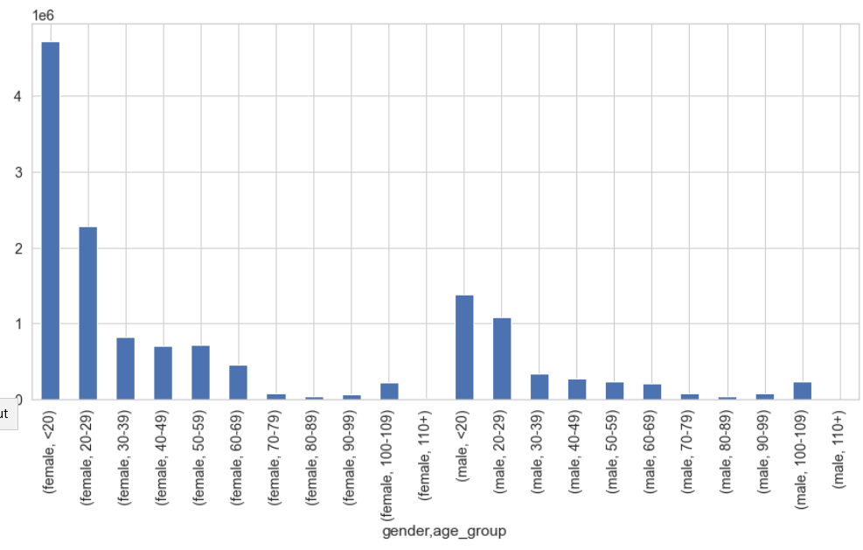
Project analysis slide 2
EDA
Which age groups receive more likes?
Females receive more likes compared to males of the same age group. Females aged less than 20 receive the highest number of likes.

Slide 12
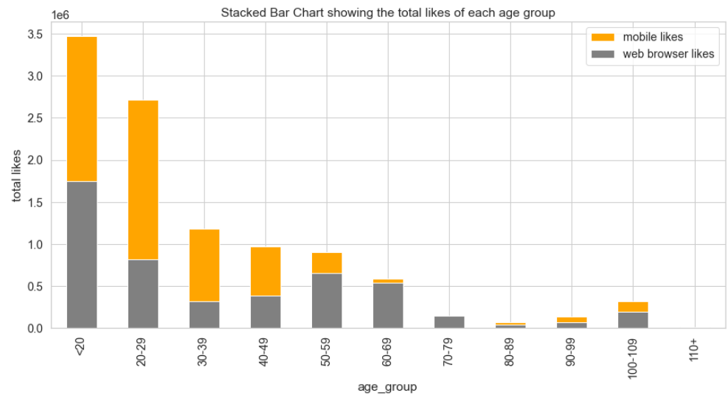
Project analysis slide 2
EDA
Which medium is preferred for using facebook?
Mobile is preferred medium over web browser. Facebook should invest/continue investing its efforts for improvements and revenue generation in the mobile platform.

Slide 13
Project analysis slide 2
SUMMARY
As male users exceed female users by 18.6%, facebook can think of ways in which it can make itself more appealing, user-friendly and convenient to the female gender
In order to increase the user base facebook should focus on the population above 30 years of age.
The usage pattern of females and males differs. Females like more posts and receive more likes for their posts. Facebook should further analyze these behaviours and understand attributes other than likes information to provide more value add to the male population.
Likes and likes received reduce with increase in age, implying that the reaction and preception to user posts is dependant on age. Facebook can customize its offerings based on user age group.
There is an increase in facebook activity in terms of friend count, likes and likes received after 80 years of age. Facebook can think of providing more value added solutions for senior citizens in this age group.
As there are more mobile users than web, facebook should direct its marketing and revenue generating activities more through the mobile application medium

Slide 14
Thank You

